Slide 1
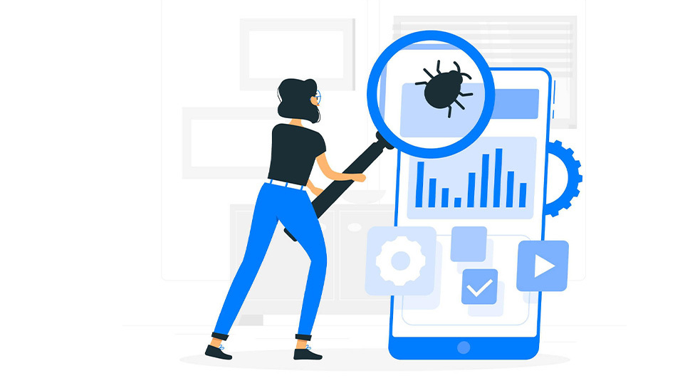


Mobile Testing

Slide 2
Mobile Testing
Mobile Device Testing
Mobile Application Testing

Slide 3
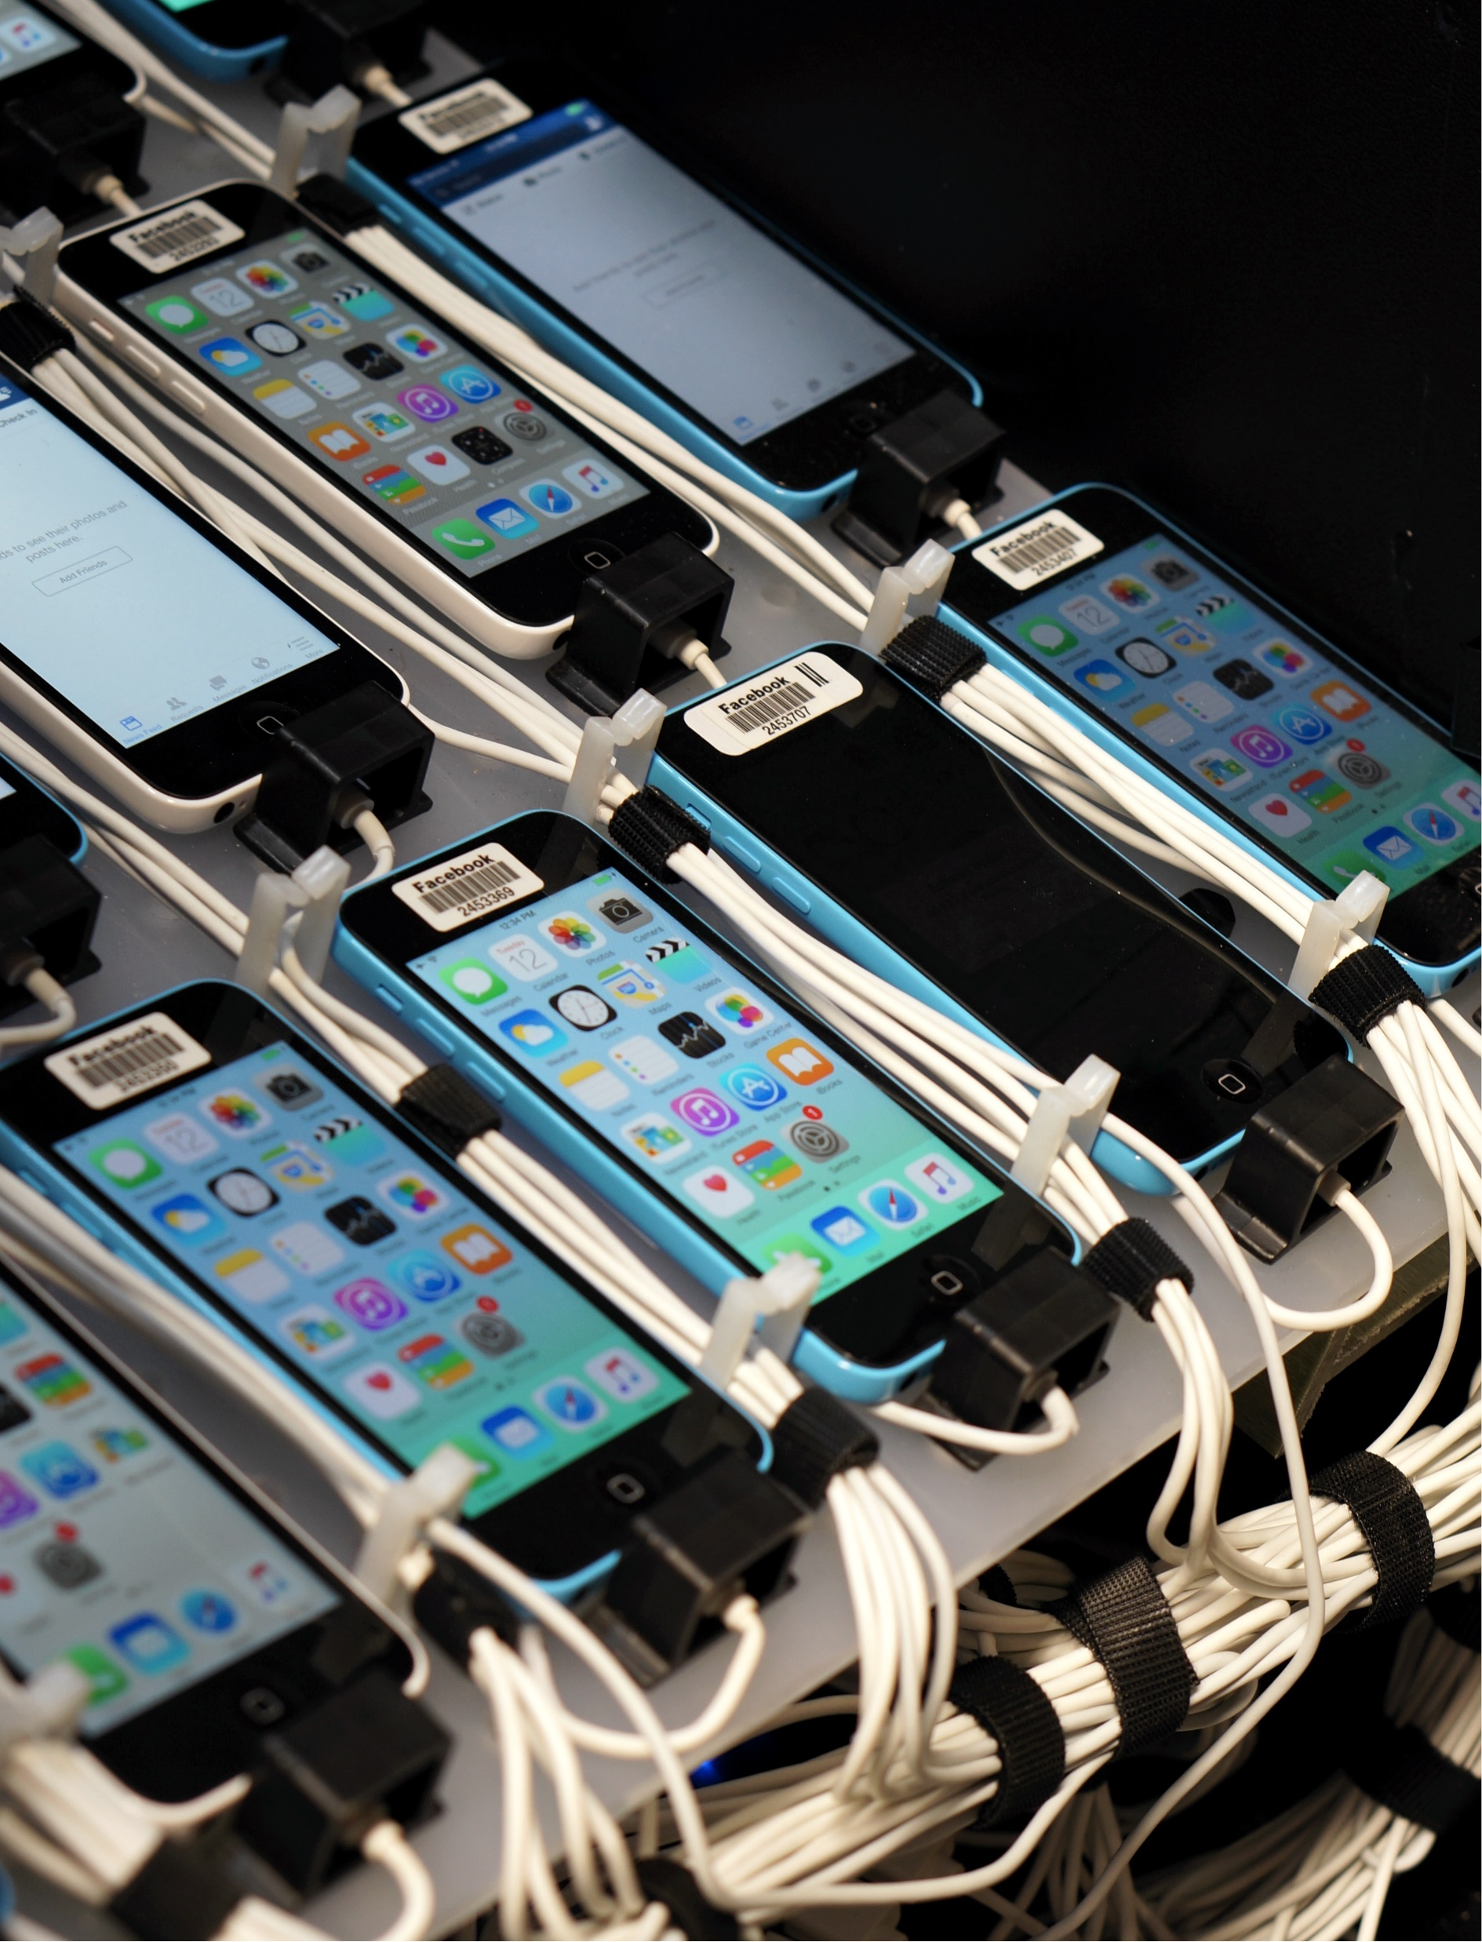
Mobile device testing
Device Testing is the process by which a Device is tested for its Quality to see how well it meets the requirements for which it has been developed
Mobile device testing examines a device’s quality – by validating its hardware and software functions. This process aims to test features, i.e., screen, memory, camera. It also consists of factory testing and certification testing.

Slide 4
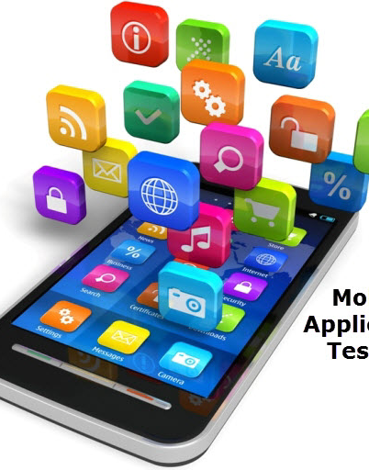
Mobile App testing
Mobile application testing means a process in which an application developed for handheld mobile devices is tested to ensure its functionality, usability, and consistency. Testers can perform mobile application testing manually or with automation.

Slide 5
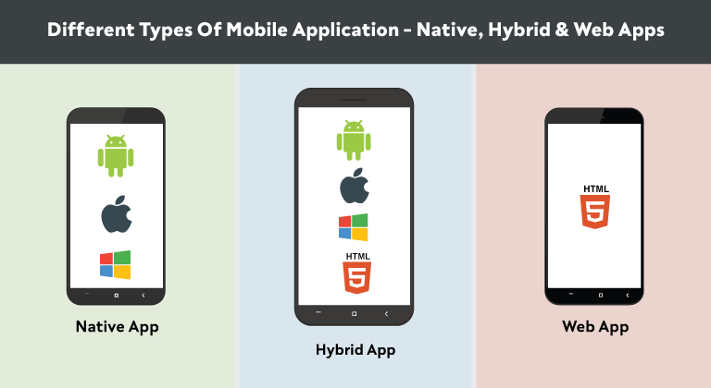
Types of mobile applications
Native Application A native application is a software application built in a specific programming language for the particular device platform, iOS or Android. It can be easily installed into your devices and available in the application store (Google Play for Android and App Store for iOS), for example, Angry bird, Swish, Watsapp
Web Application A web application runs inside a mobile web browser, such as Chrome, Firefox, Opera, Safari using a mobile network or WIFI. For instance, some of the web applications are m.facebook.com, m.gmail.com, etc.
Hybrid Application A hybrid application is a combination of a native app and a web app. Even though this type of application can be installed on a device just like a native app, it is a web app built with HTML, CSS, or JavaScript and runs in a web view. E.g. Facebook, Amazon

Slide 6
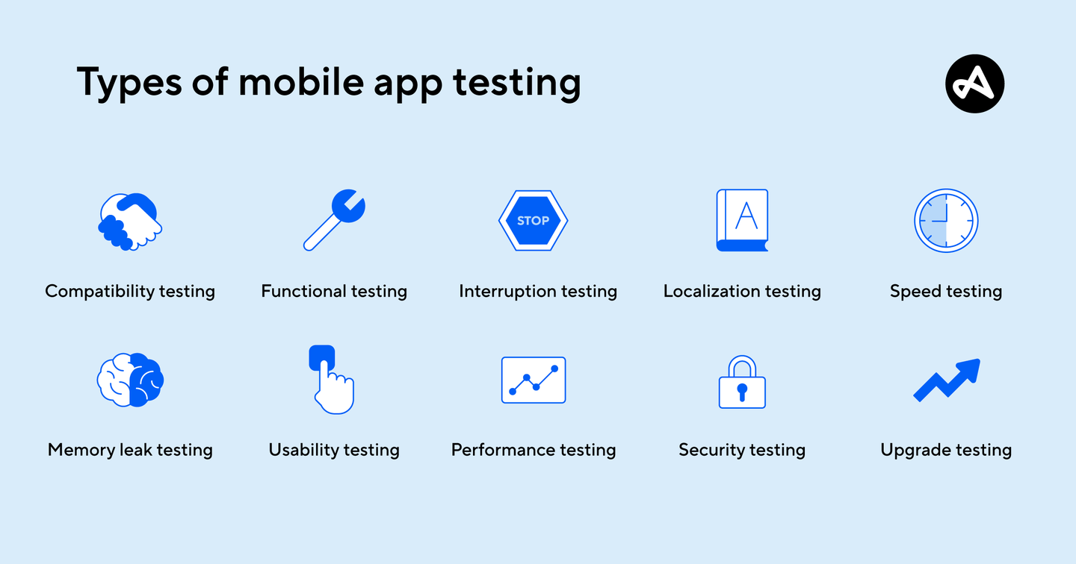

Slide 7
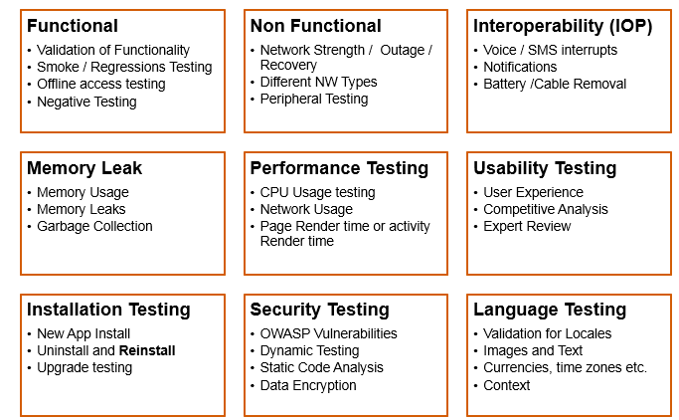
Types of Mobile testing

Slide 8
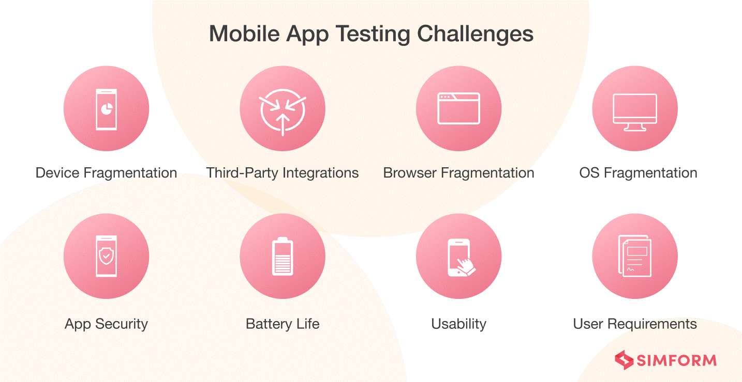
Mobile App testing Challenges

Slide 9
Mobile Testing Device
Device
Virtual device
Emulators
Simulator
Real Device
Real testing devices are the various models of mobile handsets used to run the website or app to test its functioning and behavioural patterns. These are actual handsets that the end user would use.
A Virtual Testing Device is a software program on the computer, unlike a real device, that provides simulation for most of the important features of an actual smartphone device.
An Emulator is a software that mimics the hardware and software of the target device on your computer.
A Simulator is a software that helps your computer run certain programs built for a different Operating System. They are mostly meant for iPhone and iPad devices, unlike Android devices that can be emulated easily.

Slide 10
To be Continued…

